Slide 1


A Brief Review of CIMI Progress, Plans, and Goals
HIEA Meeting
Rosslyn, VA August 17, 2016
Stanley M Huff, MD
Chief Medical Informatics Officer

Slide 2
Why?
“To help people live the healthiest lives possible.”
4

Slide 3
Graphic of a Detailed Clinical Model
SystolicBPObs
SystolicBP
data
138 mmHg
LOINC
quals
BodyLocation
BodyLocation
data
Right Arm
PatientPosition
PatientPosition
SNOMED CT
data
Sitting
5

Slide 4
The Interoperable App Development Process
Project Needs
Pediatric Growth Chart
Neonatal Bilirubin
OPA Data Collection
MQIP
ACC registries
Comm Acq Pneumonia
Etc.
Create Logical
Models
(CIMI)
Approve
Models
Model
Repository
Terminology
Server
(SOLOR)
Create
Physical
Artifacts
Pediatric Growth Chart
Neonatal Bilirubin
OPA Data Collection
MQIP
ACC registries
Comm Acq Pneumonia
Etc.
Create
Software
(Apps, CDS)
Artifact
Repository
(FHIR profiles)

Slide 5
CIMI
The Clinical Information Modeling Initiative (CIMI) is an HL7 Work Group that is producing detailed clinical information models to enable interoperability of health care information systems
CIMI was initiated during a “Fresh Look” session at an HL7 meeting in 2011
CIMI models are free for use for all purposes
See http://www.opencimi.org/ for more details

Slide 6
CIMI Goals
Create a shared repository of detailed clinical information models
Repository is open to everyone and models are licensed free for use at no cost
Where the models:
Are expressed in an approved formalism
Archetype Definition Language (ADL)
Archetype Modeling Language (AML)
Are based on a core reference model, including a set of base data types
Have formal bindings to standard coded terminologies

Slide 7
CIMI creates “computable logical models.”
The models are algorithmically processable
Models show the structural relationship of the model elements (containment)
Models are expressed in a formal computable format
Coded elements have explicit binding to allowed coded values (attributes and values)
Models are independent of any specific programming language, implementation technology, or type of database
The models must support explicit, unambiguous query statements against data instances

Slide 8
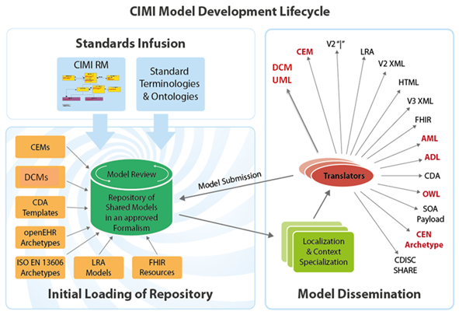
Standard
Terminologies
(SOLOR)
LEGOs
FHIM

Slide 9
Work Completed
Core CIMI reference model
Base classes and data type definitions
Reference archetypes
Observation
Laboratory Observation
CIMI model browser
~2,500 laboratory models
http://www.clinicalelement.com/cimi-browser/#/

Slide 10
Current Activities
Development of tools
Model authoring, value set authoring, app development
Import of 6,000+ Intermountain models
FHIR “Dictionaries”
CIMI Profiles and Conformance Testing
To Do
Further refinement and use of AML
CIMI registry and adoption tables
Development of new content: vital signs, diagnoses, procedures, patient measures, …

Slide 11
SOLOR, LEGOs, and CIMI
SOLOR
Terminology server
Repository for new CIMI content (CIMI SNOMED extension)
SNOMED CT – concepts for semantic (meaning) bindings
SNOMED CT – pre and post coordination mapping
Inferences and reasoning
LEGOs
Semantic model content
Semantic classifier

Slide 12
FHIM and CIMI
FHIM Classes
Observation
Lab Obs
Patient Obs
Family Hx Obs
FHIM Subtypes
Qn Lab Obs
Qual Lab Obs
Titer Lab Obs
Hematocrit
Serum Glucose
Urine Sodium
Invariant Profile Structure – CIMI Leaf Node Content

Slide 13
Argonauts and CIMI
We agree with the need for everything the Argonauts are doing
Current scope of the Argonaut work will not achieve true plug-n-play interoperability
Meaningful use common data elements
DAF profiles (high level profiles)
Small number of detailed models
Vital signs (measurements only, no qualifying information)
CIMI adds detailed content for plug-n-play interoperability
Lab measurements
Patient measurements
Physical exam
Intake and Output
Assessment instruments: Apgars, Braden, Pain Scales, etc.

Slide 14
Questions?

Slide 15
Appendix

Slide 16
Model Repository and Model Adoption
Model Repository
Model Id | Status | Version | Isosemantic Family | Model content | Meta data
Hematocrit | DSTU | 2 | 2123 | XXXX | YYY
Blood Pressure | Incomplete | 1 | 4578 | XXXX | YYY
Heart Rate | In Use | 3 | 4190 | XXXX | YYY
White Cell Count | In Use | 5 | 1789 | XXXX | YYY
Serum Glucose | DSTU | 2 | 3675 | XXXX | YYY
Serum Bilirubin | In Use | 3 | 5367 | XXXX | YYY
Model Adoption
Model Id | Realm | Use Case | Meta data
Heart Rate | US | Public Health Reporting | YYY
Hematocrit | AUS | Standard Lab Results | YYY
Serum Glucose | US | MU Quality Measure | YYY
Serum Glucose | International | CIMI | YYY
Serum Glucose | International | openEHR | YYY
Serum Bilirubin | HSPC | Neonatal Bilirubin App | YYY

Slide 17
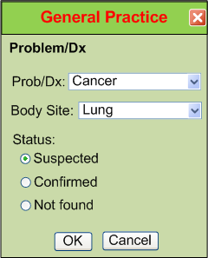
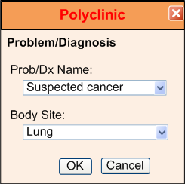
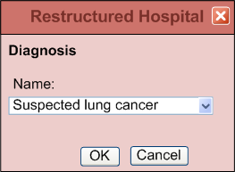
IsoSemantic Models – Example of Problem
(from Dr. Linda Bird)
e.g. “Suspected Lung Cancer”

Slide 18
Data Comes in Different Shapes and Colors
Finding – Suspected Lung Cancer
Finding – Suspected Cancer
Location – Lung
Finding – Cancer
Location – Lung
Certainty – Suspected
(Let’s say this is the preferred shape)

Slide 19

Data Standardized in the Service
Application
Application
and User
Data in preferred shape and color
Shape and color translation
Shape and color of data
in the local database

Slide 20
Partial Interoperability
Application
Application
and User
Standard Terms
(Non-standard Structure)
Term
Translators
Local databases,
CDA, HL7 V.2, etc.

Slide 21
Preferred Strategy – Full Interoperability
Application
Application
and User
Standard Structure
AND Standard Terms
(As defined by CIMI Models)
Requirements
Term and
Structure
Translators
Local databases,
CDA, HL7 V.2, etc.

Slide 22
Reasons to do it on the server side
Person writing the translation is most likely to understand the meaning of the data in their own database.
The person writing the translation only has to understand their own data and the preferred model.
They can optimize query execution for their own system
The query for the data is simpler. If the application has to write a query that will work for all shapes, the query will be inefficient to process by every system.

Slide 23
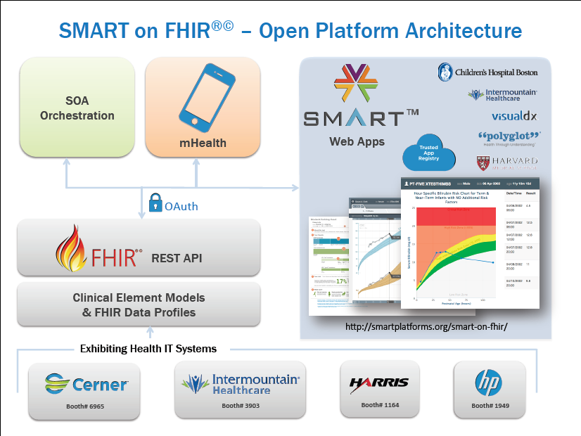

Slide 24
CIMI Vision, Mission, and Goals

Slide 25
What Is Needed to Create New Paradigm?
Standard set of detailed clinical data models coupled with…
Standard coded terminology
Standard API’s (Application Programmer Interfaces) for healthcare related services
Open sharing of models, coded terms, and API’s
Sharing of decision logic and applications

Slide 26
Clinical modeling activities
Netherlands/ISO Standard
ISO EN 13606
UK – NHS and LRA
Singapore
Sweden
Australia
openEHR Foundation
Canada
US Veterans Administration
US Department of Defense
Intermountain Healthcare
Mayo Clinic
MLHIM
Others….
SemanticHealthNet
HL7
Version 3 RIM, message templates
TermInfo
CDA plus Templates
Detailed Clinical Models
greenCDA
Tolven
NIH/NCI – Common Data Elements, CaBIG
CDISC SHARE
Korea - CCM
Brazil

Slide 27
Clinical Information Modeling Initiative
Mission
Improve the interoperability of healthcare systems through shared implementable clinical information models.
(A single curated collection.)

Slide 28
CIMI Goals
Create a shared repository of detailed clinical information models
Repository is open to everyone and models are licensed free for use at no cost
Where the models:
Are expressed in an approved formalism
Archetype Definition Language (ADL)
Archetype Modeling Language (AML)
Are based on a core reference model, including a set of base data types
Have formal bindings to standard coded terminologies

Slide 29
Goal: Models supporting multiple contexts
EHR data storage
Message payload and service payload
Decision logic (queries of EHR data)
Clinical trials data (clinical research)
Quality measures
Normalization of data for secondary use
Creation of data entry screens (like SDC)
Capture of coding output from NLP

Slide 30
Roadmap (some parallel activities)
Choose supported formalism(s) - Done
Define the core reference model, including data types (leaf types) - Done
Define modeling style and approach - Ongoing
Patterns
Development of “style” will continue as we begin creating content

Slide 31
Roadmap (continued)
Create an open shared repository of models
Requirements
Find a place to host the repository
Select or develop the model repository software
Create model content in the repository
Start with existing content that participants can contribute
Must engage clinical experts for validation of the models

Slide 32
Roadmap (continued)
Create a process for curation and management of model content
Resolve and specify IP policies for open sharing of models
Find a way of funding and supporting the repository and modeling activities
Create tools/compilers/transformers to other formalisms
Must support at least ADL, AML
High priority: Semantic Web, HL7
Create tools/compilers/transformers to create what software developers need (joint work)
Examples: FHIR profiles, XML schema, Java classes, CDA templates, greenCDA, etc.

Slide 33
Modeling at Intermountain
1994 – Models using Abstract Syntax Notation 1 (ASN.1)
~ 2000 – attempt modeling with XML Schema
No terminology binding capabilities, no constraint language
2004 – models using Clinical Element Modeling Language (CEML), 5000+ models
2009 – models converted to Constraint Definition Language (CDL)
2013 – models converted back to CEML
2014 – models in ADL, and FHIR profiles

Slide 34
Intermountain Plans
Continue to use CEML internally for now
Intermountain models are available at
www.clinicalelement.com
Translate CEML models to FHIR profiles - interim
Translate CEML models to ADL 1.5
Contribute converted models to CIMI
Place models in the CIMI repository with “proposed status”
Models reviewed and modified to conform to CIMI standards and style
Translate CIMI models to FHIR profiles – long term solution

Slide 35
Selected CIMI Policies, Decisions, and Milestones

Slide 36
Decisions (London, Dec 1, 2011)
We agreed to:
ADL 1.5 as the initial formalism, including the Archetype Object Model
A CIMI UML profile (Archetype Modeling Language, AML) will be developed concurrently as a set of UML stereotypes, XMI specifications and transformations

Slide 37
Definition of “Logical Model”
Models show the structural relationship of the model elements (containment)
Coded elements have explicit binding to allowed coded values
Models are independent of a specific programming language or type of database
Support explicit, unambiguous query statements against data instances

Slide 38
Implementation Strategy
As needed, we will make official mappings from the CIMI logical models to particular implementations (logical data types -> physical data types)
FHIR resources and profiles
CCDA
Java classes
HL7 V3 messaging
Etc.

Slide 39
Further modeling decisions
One or more Examples of instance data will be created for each model
The examples will show both proper and improper use
Models shall specify a single preferred unit of measure (unit normalization)
Models can support inclusion of processing knowledge (default values)

Slide 40
Isosemantic Models
CIMI supports isosemantic clinical models:
We will keep isosemantic models in the CIMI repository that use a different split between pre-coordination versus post coordination (different split between terminology and information model)
One model in an isosemantic family will be selected as the CIMI preferred model for interoperability (as opposed to everyone supporting every model)
Collections of models for specific use cases will be created by authoritative bodies: professional societies, regulatory agencies, public health, quality measures, etc.

Slide 41
Terminology
SNOMED CT is the primary reference terminology
LOINC is also approved as a reference terminology
In the event of overlap, SNOMED CT will be the preferred source
(Propose that LOINC be used for lab observations - Stan)
CIMI will propose extensions to the reference terminologies when needed concepts do not exist
CIMI will have a place to keep needed concepts that are not a part of any standard terminology
CIMI has obtained a SNOMED extension identifier
CIMI will adhere to IHTSDO Affiliate’s Agreement for referencing SNOMED codes in models
Copyright notice in models, SNOMED license for all production implementations
CIMI will create a Terminology Authority to review and submit concepts to IHTSDO as appropriate

Slide 42
Terminology (cont)
The primary version of models will only contain references (pointers) to value sets
We will create tools that read the terminology tables and create versions of the models that contain enumerated value sets (as in the current ADL 1.5 specification) as needed

Slide 43
Additional Decisions
CIMI data types have been approved
CIMI Reference Model (Mini-CIMI) has been approved
A set of reference archetypes have been approved

Slide 44
March 29, 2012 – Semantic Interoperability
CIMI models must be capable of supporting semantic interoperability across a federation of enterprises
We will define the relationship between each parent and child node in the hierarchy
SNOMED relationship concepts will be used to define the parent-child relationships in the models
Goal: Enable use of the SNOMED CT concept model to support translation of data from pre coordinated to post coordinated representations

Slide 45
Content Ownership and Intellectual Property
Those who contribute models to CIMI will retain ownership and the IP of the models, but they grant CIMI a license to use the model content at no cost in perpetuity and to allow CIMI to sublicense the use of the models at no cost to those who use the models
New or novel IP developed as part of the CIMI process belongs to CIMI, but will be licensed free for use for all purposes in perpetuity

Slide 46
Leeds – CIMI Website
The group accepted a proposal from Portavita to provide a CIMI website.
The website would:
Provide descriptive, historical, and tutorial kinds of information about CIMI
Act as a distribution site for CIMI models and other CIMI artifacts (MindMaps, Tree Display, Examples)

Slide 47
Leeds – Approving content
The requirements for approval of CIMI content will be developed and approved by the usual CIMI work processes
Style guide and related policies
The CIMI participants have the responsibility to document the process for approving official CIMI content
The Library Board approves roles and access permissions for specific individuals relative to management of the CIMI repository
The Library Board ensures that approved processes are followed, and reports regularly to the EC

Slide 48
First draft CIMI models now available:
http://www.clinicalelement.com/cimi-browser/

Slide 49
Some Principles
CIMI DOES care about implementation. There must be at least one way to implement the models in a popular technology stack that is in use today. The models should be as easy to implement as possible.
Only use will determine if we are producing anything of value
Approve “Good Enough” RM and DTs
Get practical use ASAP
Change RM and DTs based on use

Slide 50
Primary Near Term Goals
As soon as possible, make some high quality CIMI models available in a web accessible repository
ADL 1.5 (AOM framework) and/or UML (AML, XMI)
That use the CIMI reference model
That have complete terminology bindings
Get the models used in someone’s working system
Document our experience
Improve our processes and models
Repeat!

Slide 51
Other Activities
CIMI as a Work Group in HL7
CIMI and FHIR
CIMI and HSPC
CIMI and the Logical Model Collaboration

